Slide 1
Three-dimensional sudoku SAT-solving
Graduate School of Informatics
Comparing strategies for solving three-dimensional sudokus based on clause learning

Slide 2
Outline
Motivation behind research
Hypothesis and metric
What are 3D sudokus?
Experimental setup
  Data
  Solver
  Implementation
Experimental results and conclusion
Three-dimensional sudoku SAT-solving
Notes:
In this short presentation we will walk you through our research on three-dimensional sudoku SAT-solving. We will start by motivating our research, followed by the proposed hypothesis. We will then give a short explanation of 3D sudokus and the extra constraints they pose. We will then explain the experimental setup. Finally we will share our results and the conclusion we drew from this.

Slide 3
Motivation behind research
Can we solve 3D sudokus more efficiently when using our experience of solving the related 2D subproblems?
Three-dimensional sudoku SAT-solving
Notes:
Since the invention of the 9 by 9 sudoku in 1979 by Howard Garns, many different shapes and forms of sudokus have emerged with higher difficulty for humans, one of which being the three dimensional sudoku. As a human, only thinking of solving 3D sudokus makes my head hurt, but is it also as difficult for the computer to solve this? Can we help the computer in solving the 3D sudokus by first solving the nine subproblems implicit in the 3D problem? This research tries to add to existing literature about clause learning in comparing two different strategies for solving 3D sudokus. One strategy would be to convert the 3D sudokus to CNF and solve them from this. The other strategy would be to first solve the nine two dimensional problems, remembering what we learned from this problems, and using this to (hopefully) more efficiently solve the 3D problem.

Slide 4
Hypothesis
The metric
Cryptominisat solver uses more backtracks …
when solving a 9x9x9 sudoku in CNF …
than when a strategy of first solving the nine 9x9 sudokus and adding the learned conflict-clauses to the CNF of the 9x9x9 sudoku before solving it is implemented.
Strategy without extra learning
Strategy with extra learning
Three-dimensional sudoku SAT-solving
Notes:
This gives rise to the following hypothesis: READ HYPOTHESIS. The metric is the number of backtracks. The reason for this metric is that the expectation is that the strategy with extra learning encounters the conflicts in the SAT problem sooner, hereby searching the state space more efficiently and using less backtracks in finding the solution.

Slide 5
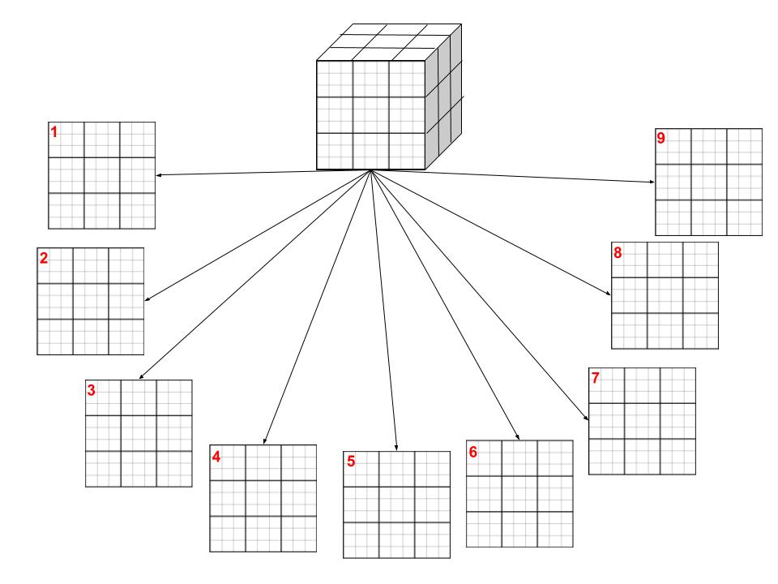
What are 3D sudokus?
Three-dimensional sudoku SAT-solving
Notes:
Three dimensional sudokus are essentially nine stacked two dimensional sudokus. So additionally to 2D constraints along the x and y axis we have a constraint for each box in the depth direction, or along the z axis. As shown in the picture, in each box with the same row and column number as in other 2D sudokus, only exactly one number with the same value can appear. The sudoku numbers now also appear in extra 3x3 regions, in which they have to satisfy the usual constraints. These extra constraints make the three dimensional CNF significantly larger than the 2D CNF.

Slide 6
Experimental setup
+/- 700 3D sudokus from www.menneske.no
Extension of CNF encoding for extra constraints in 3D
Cryptominisat
Two strategies compared
Three-dimensional sudoku SAT-solving
Notes:
The data used for this research is from menneske.no, and contains more than 5000 sudokus, but due to time constraints only 700 sudokus are used in this research. The encoding to CNF of 2D Sudokus is extended to contain the extra constraints posed by the 3D sudoku problem. Cryptominisat solver is used to solve the sudokus, because of its high performance. The two strategies of solving three dimensional sudokus are then compared by first solving the 3D sudokus from the normal CNF, then solving them with extra learned clauses from the 9 two-dimensional problems involved in each three dimensional problem.

Slide 7
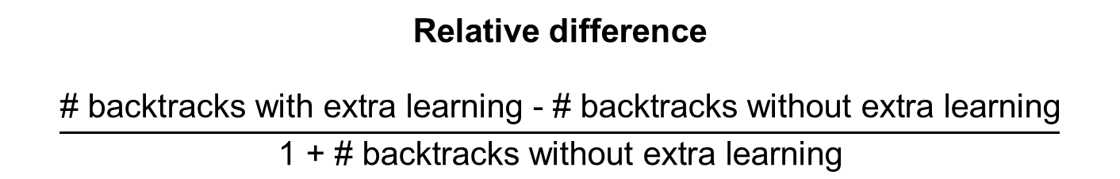
Experimental results and conclusion
Significant results for relative difference between backtracks in strategies
Some cases benefit from the strategy, some don’t
Three-dimensional sudoku SAT-solving
Notes:
The results where significant for the relative difference between number of backtracks in the strategy with extra learning and the number of backtracks without extra learning. The results implied that relatively speaking there are more backtracks with extra learning than without extra learning. This contradicts our original hypothesis, and we think this might be because our assumption that the learned conflict-clauses from the two-dimensional problem are relevant for the three-dimensional problem could be wrong. Maybe these extra added clauses are redundant and do not help at all in solving the three dimensional problem. The results still showed that for some cases the strategy with extra learing might be beneficial and for future research it might be interesting to find out what makes properties of the sudokus in these cases cause the strategy to be beneficial for them.

